Slide 1
Streams In Java

Slide 2
Stream In Java
Introduced in Java 8, the Stream API is used to process collections of objects. A stream is a sequence of objects that supports various methods which can be pipelined to produce the desired result. The features of Java stream are –
A stream is not a data structure instead it takes input from the Collections, Arrays or I/O channels.
Streams don’t change the original data structure, they only provide the result as per the pipelined methods.
Each intermediate operation is lazily executed and returns a stream as a result, hence various intermediate operations can be pipelined. Terminal operations mark the end of the stream and return the result.

Slide 3
package javaprogram;
/* Title:StreamTest.java
* Author:Rajiv Ranjan
* Description:Program to create stream
* Date:7-1-2022
*/
import java.util.stream.*;
public class StreamTest {
public static void main(String ar[])
{
Stream<Integer> stream = Stream.of(1,2,3,4,5,6,7,8,9);
stream.forEach(p -> System.out.println(p));
}
}
}

Slide 4
package javaprogram;
/* Title:StreamTest.java
* Author:Rajiv Ranjan
* Description:Program to create stream
* Date:17-1-2022
*/
import java.util.*;
import java.util.stream.*;
public class StreamArray {
public static void main(String ar[])
{
List<Integer> list = Arrays.asList(1, 1, 2, 3, 3, 4, 5, 5);
Stream obst=list.stream();
obst.forEach(p -> System.out.println(p));
}
}

Slide 5
Java 8 Stream Intermediate And Terminal Operations :
1) The main difference between intermediate and terminal operations is that intermediate operations return a stream as a result and terminal operations return non-stream values like primitive or object or collection or may not return anything.
2) As intermediate operations return another stream as a result, they can be chained together to form a pipeline of operations. Terminal operations can not be chained together.
6) Intermediate Operations :
map(), filter(), distinct(), sorted(), limit(), skip()
Terminal Operations :
forEach(), toArray(), reduce(), collect(), min(), max(), count(), anyMatch(), allMatch(), noneMatch(), findFirst(), findAny()

Slide 6
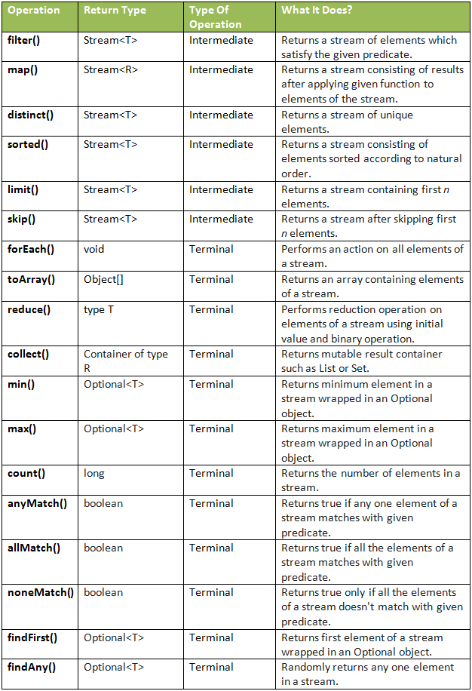

Slide 7
import java.util.*;
import java.util.stream.Stream;
/* Title:StreamFilterTest.java
* Author:Rajiv Ranjan
* Description:Program to demonstrate filter method
* Date:17-1-2022
*/
public class StreamFilterJava {
public static void main(String ar[])
{
ArrayList<Integer> myList = new ArrayList<Integer>();
myList.add(20);
myList.add(30);
myList.add(40);
myList.add(50);
Stream<Integer> sequentialStream = myList.stream();
Stream<Integer> highNums = sequentialStream.filter(p -> p > 30); //filter numbers greater than 30
System.out.print("High Nums greater than 30=>");
highNums.forEach(p -> System.out.print(p+" "));
}
}
High Nums greater than 30=>40 50

Slide 8
package javaprogram;
import java.util.*;
import java.util.stream.Stream;
import java.util.stream.Collectors;
/* Title:StreamForEach.java
* Author:Rajiv Ranjan
* Description:Program to demonstrate forEach method
* Date:17-1-2022
*/
public class StreamForEachJava {
public static void main(String ar[])
{
Stream<Integer> numbers = Stream.of(1,2,3,4,5);
numbers.forEach(i -> System.out.print(i+",")); //1,2,3,4,5
}
}

Slide 9
package javaprogram;
/* Title:StreamCollectJava.java
* Author:Rajiv Ranjan
* Description:Program to demonstrate Collectors method
* Date:17-1-2022
*/
import java.util.Arrays;
import java.util.List;
import java.util.stream.Collectors;
public class StreamCollectJava {
public static void main(String[] args) {
List<String> names = Arrays.asList("Melisandre","Sansa","Jon","Daenerys","Joffery");
List<String> longnames = names.stream().filter(str->str.length()>6).collect(Collectors.toList());
longnames.forEach(p->System.out.println(p));
}
}
Melisandre
Daenerys
Joffery

Slide 10
package myprogwire;
import java.util.List;
import java.util.stream.*;
public class MyStream {
public static void main(String ar[])
{
Stream st=Stream.of(1,2,3,4);
List ls=st.toList();
ls.forEach(System.out::println);
Stream<Integer> sttwo=Stream.of(1,2,3,4);
List<Integer> pq=sttwo.filter(p->p>2).collect(Collectors.toList());
pq.forEach(System.out::println);
}
}
1
2
3
4
3
4

Slide 11
Stream map() example: We can use map() to apply functions to an stream. Let’s see how we can use it to apply upper case function to a list of Strings.
Stream<String> names = Stream.of("aBc", "d", "ef");
System.out.println(names.map(s -> {
return s.toUpperCase();
}).collect(Collectors.toList()));

Slide 12
package javaprogram;
/* Title:StreamTestAllMatch.java
* Author:Rajiv Ranjan
* Description:Program to demonstrate allMatch
* Date:17-1-2022
*/
import java.util.*;
import java.util.stream.*;
public class StreamTestAllmatch {
public static void main(String a[])
{
Stream<Integer> numbers4 = Stream.of(1,2,3,4,5);
System.out.println("Stream contains all elements less than 10? "+numbers4.allMatch(i -> i<10));
//Stream contains all elements less than 10? true
}
}

Slide 13
package javaprogram;
/* Title:StreamTestAnyMatch.java
* Author:Rajiv Ranjan
* Description:Program to demonstrate AnyMatch
* Date:17-1-2022
*/
import java.util.*;
import java.util.stream.*;
public class StreamTestAnyMatch {
public static void main(String a[])
{
Stream<Integer> numbers3 = Stream.of(1,2,3,4,5);
System.out.println("Stream contains 4? "+numbers3.anyMatch(i -> i==4));
}
}

Slide 14
package javaprogram;
import java.util.*;
import java.util.stream.*;
/* Title:StreamTestCount.java
* Author:Rajiv Ranjan
* Description:Program to demonstrate count method
* Date:17-1-2022
*/
public class StreamTestCount {
public static void main(String a[])
{
// Creating a list of strings
List<String> list = Arrays.asList("Test", "Test", "One","Myname", "for", "Test","mohit");
// Storing the count of distinct elements
// in the list using Stream.distinct() method
long Count = list.stream().distinct().count();
// Displaying the count of distinct elements
System.out.println("The count of distinct elements is : " + Count);
}
}
The count of distinct elements is : 5

Slide 15
package javaprogram;
import java.util.*;
import java.util.stream.*;
/* Title:StreamTestNoneMatch.java
* Author:Rajiv Ranjan
* Description:Program to demonstrate count method
* Date:17-1-2022
*/
public class StreamTestNoneMatch {
public static void main(String a[])
{
Stream<Integer> numbers5 = Stream.of(1,2,3,4,5);
System.out.println("Stream doesn't contain 10? "+numbers5.noneMatch(i -> i==10));
//Stream doesn't contain 10? true
}
}
Stream doesn't contain 10? true

Slide 16
package javaprogram;
/* Title:StreamTestSort.java
* Author:Rajiv Ranjan
* Description:Program to demonstrate sorted method
* Date:17-1-2022
*/
import java.util.*;
import java.util.stream.*;
public class StreamTestSort {
public static void main(String a[])
{
Stream<String> names3 = Stream.of("one", "two", "three", "four");
List<String> naturalSorted = names3.sorted().collect(Collectors.toList());
System.out.println(naturalSorted);
}
}
[four, one, three, two]

Slide 17
import java.util.stream.*;
import java.util.*;
class MyAgeComp implements Comparator<Integer>
{
public int compare(Integer e1,Integer e2)
{
return e1-e2;
}
}
class MyStreMax
{
public static void main(String ar[])
{
Stream<Integer>st=Stream.of(3,7,8,10);
Optional ot=st.max(new MyAgeComp());
System.out.println(ot.get());
}
}

Slide 18
Optional Class in java
In Java 8, we have a newly introduced Optional class in java.util package. This class is introduced to avoid NullPointerException that we frequently encounters if we do not perform null checks in our code. Using this class we can easily check whether a variable has null value or not and by doing this we can avoid the NullPointerException.

Slide 19
package javaprogram;
/* Title:OptionalExample.java
* Author:Rajiv Ranjan
* Description:Program to demonstrate Optional class
* Date:17-1-2022
*/
import java.util.Optional;
public class OptionalExample {
public static void main(String[] args) {
String[] str = new String[10];
str[5]="FOR CHECK";
Optional<String> checkNull = Optional.ofNullable(str[5]);
if(checkNull.isPresent()){ // check for value is present or not
String lowercaseString = str[5].toLowerCase();
System.out.print(lowercaseString);
}else
System.out.println("string value is not present");
}
}
for check

